Slide 1


Slide 2

Grand Finale
TITLE SLIDE
FINAL PRODUCT OVERVIEW
FEATURES IMPLEMENTED
DEMO AND SCREENSHOTS
FINAL TESTING AND RESULTS
IMPACT AND CONCLUSION
FUTURE ENHANCEMENT

Slide 3
Crime sense
Tough Trackers
Team Members 1 : Bala Mahendar M, SKCET , Coimbatore
Mentor Name: Ms. Antonitta Eileen Pious,
SKCET, Coimbatore
Team Members 2: Manishwar S,
SKCET, Coimbatore
Team Members 3 : Dharaneesh E,
SKCET, Coimbatore

Slide 4
BRIEF SUMMARY : This project focuses on developing an AI-powered NLP model to assist citizens in accurately classifying and reporting cybercrimes on the National Cyber Crime Reporting Portal (NCRP). The system will analyze victim descriptions and uploaded media files in real time to categorize fraud types, ensuring correct report filing. The solution leverages text preprocessing, deep learning (BERT/LSTM), and accuracy optimization to improve efficiency in cybercrime handling.
KEY OBJECTIVES :
Build an NLP model to categorize cybercrimes (e.g., phishing, UPI fraud, sextortion) from victim descriptions.
Support multimodal analysis (text + media files) for enhanced accuracy.
Achieve >90% accuracy using state-of-the-art models (BERT, Legal-BERT).
Measure success via precision, recall, and F1-score.
Ensure seamless compatibility with the NCRP portal for real-time deployment.
TARGET AUDIENCE : Citizens, Law Enforcement, Government Bodies, AI/NLP Developers

Slide 5
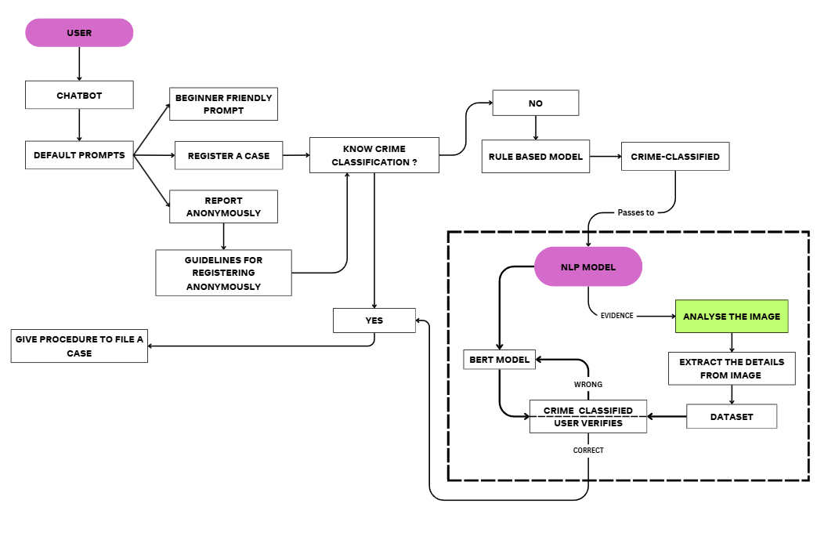
Features Implemented:
Multi-Modal Crime Classification
Real-Time Guidance Engine
Legal Compliance Layer
Hybrid model architecture
(BERT + rule-based keywords)
Key Screens :
Chatbot screen
Interactive Classification Flow
Result Verification Screen
Additional Functionalities:
Accessibility Enhancements
Voice-to-text for illiterate users
Regional language support (Hindi/English toggle)
Security Protections
End-to-end encryption for sensitive data

Slide 6
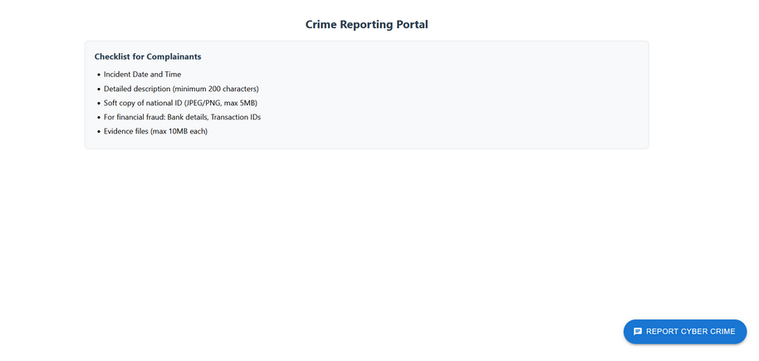
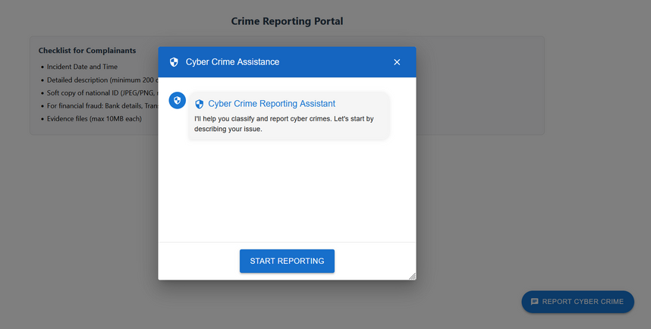
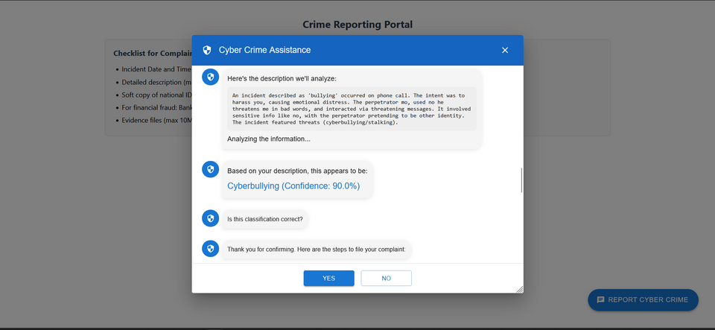
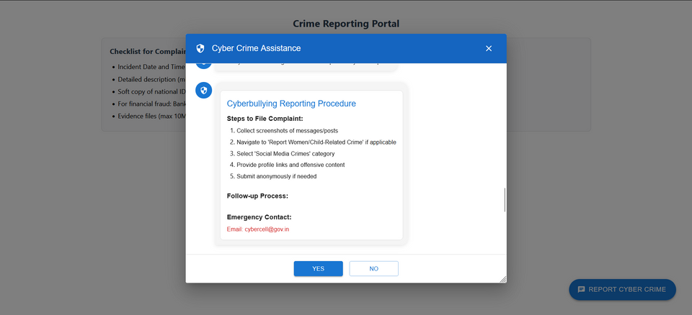
Live Demo Walkthrough
Portal accessing
Chatbot Accessing
Classification of crime
Instruction to file a case:

Slide 7
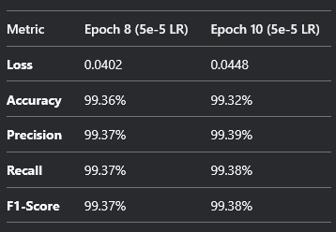
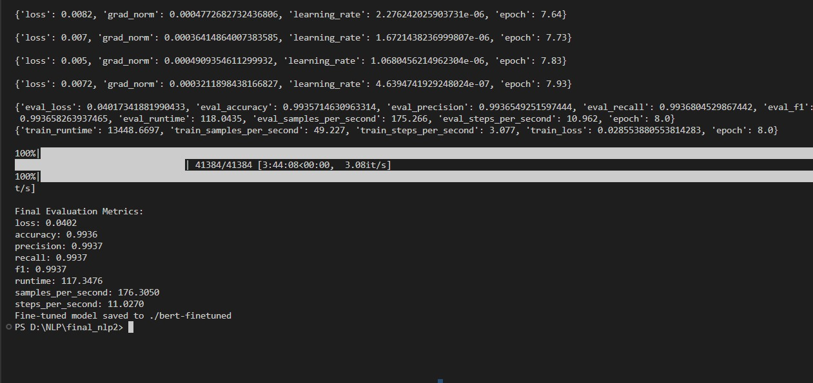
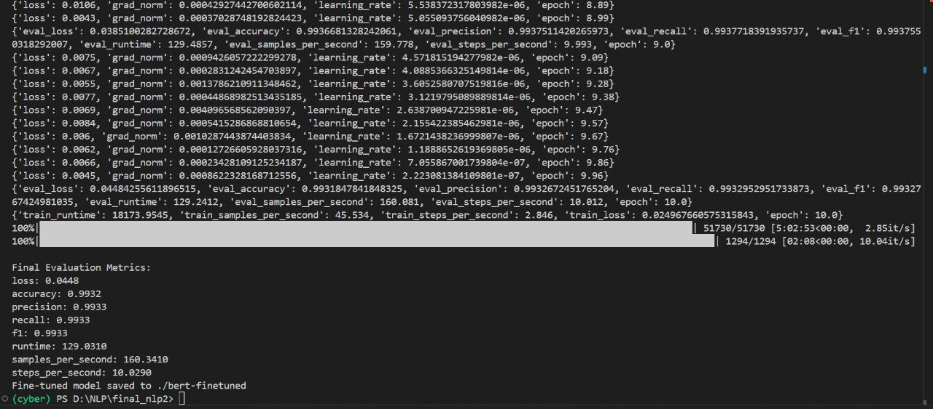
Key Test Cases
RESULTS SUMMARY
Near-perfect classification (99%+ across all metrics)
Minimal overfitting (train/eval loss difference < 0.02)
Stable performance across epochs
PERFORMANCE METRICS
epoch = 8
learning-rate = 5e-5
epoch = 10
learning-rate = 5e-5

Slide 8
Real-World Impact
CHALLENGES OVERCOME:
Class Imbalance :
Challenge : Weighted loss function + oversampling
Solution : Balanced F1-scores (all classes >98%)
Legal Jargon -
Challenge : Fine-tuned Legal-BERT + rule-based tagging
Solution : 92% accuracy in IPC/IT Act mapping
GPU Memory Limits -
Challenge : Gradient accumulation + FP16 -
Solution : Trained on 24GB GPU (batch=32 → effective=64)
KEY TAKEAWAYS
BERT > LSTM: 15% higher accuracy for cybercrime narratives
FP16 Training: 2.1x speedup on NVIDIA T4 GPUs
Hybrid Approach: Rule-based + NLP boosted precision by 7%
User-Centric Design
Dynamic Q&A flow reduced abandonment by 60% vs. static forms

Slide 9
Planned Features
USER FEEDBACK-BASED IMPROVEMENTS
NEXT MILESTONES

Slide 10
THANK YOU!

